Slide 1
Big Data Architecture and Governance
Group Project | Covid-19
Chinmay Arolkar, Foram Javia, Aishwarya Kumar

Slide 2
Introduction
We have used Covid-19 dataset for our Big data architecture and governance project.
Covid-19 dataset consist of various fields like City, County, State, Colleges, Cases, Date etc.
Data cleaning, profiling and visualization is done in Python
Data mapping and integration is done using Neo4j
Various columns have been used to create nodes and store properties in it and they have been mapped creating relationships

Slide 3
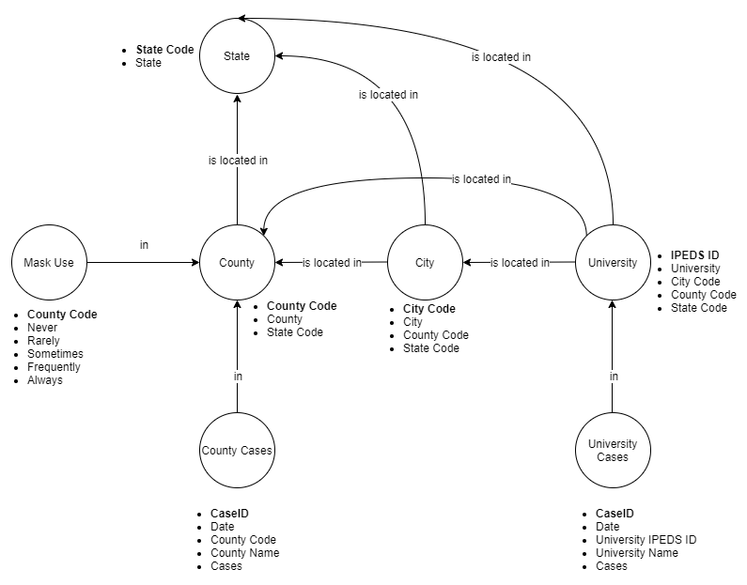
Design

Slide 4
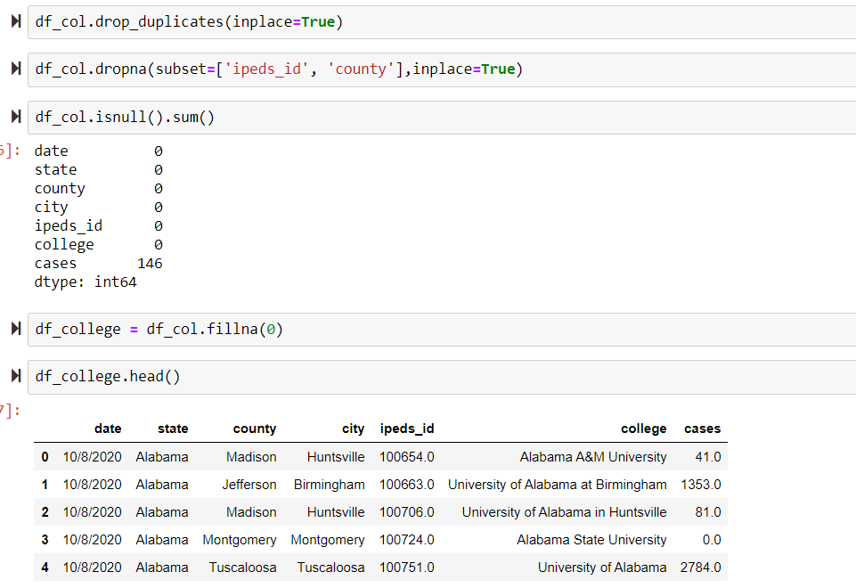
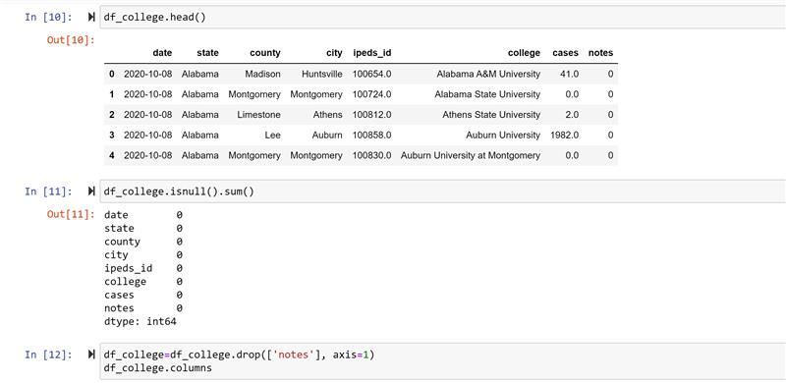
Data Wrangling and Cleansing
Cleaned the data using Python
Removed/Filled null and duplicate values
Dropped not required columns

Slide 5
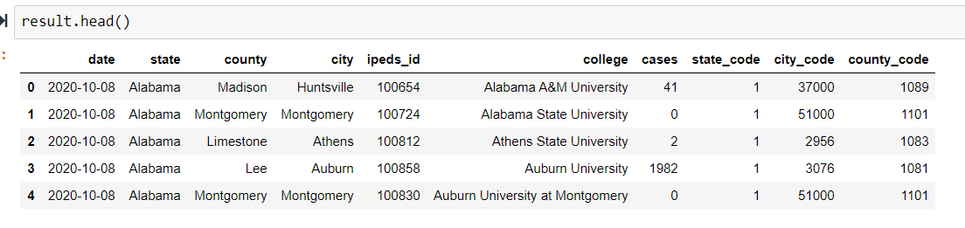
Data Wrangling and Cleansing
Filtering and Aggregation
Merged tables to show lowest granularity of data i.e. City
Derived new columns
Converted datatypes of the columns

Slide 6
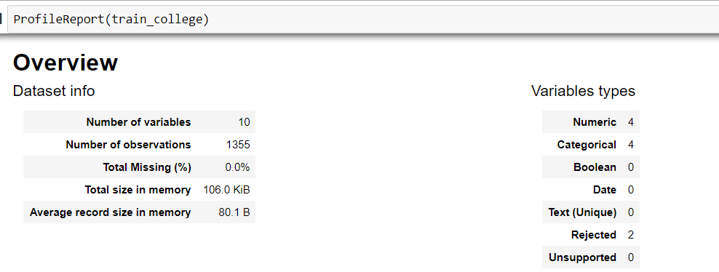
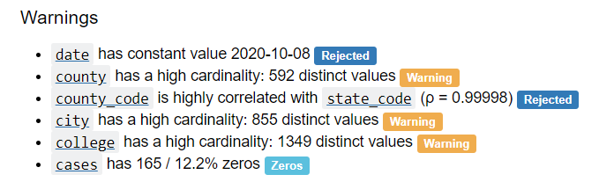
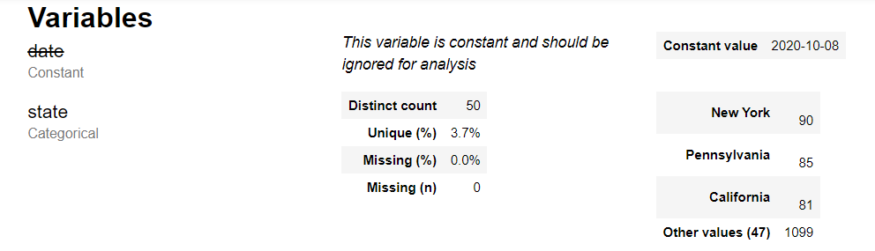
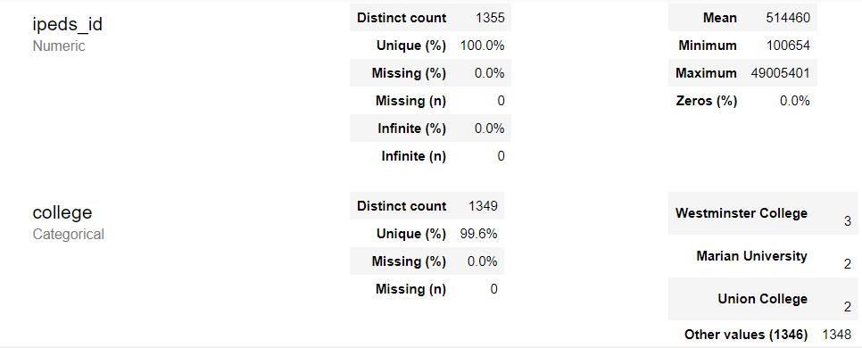
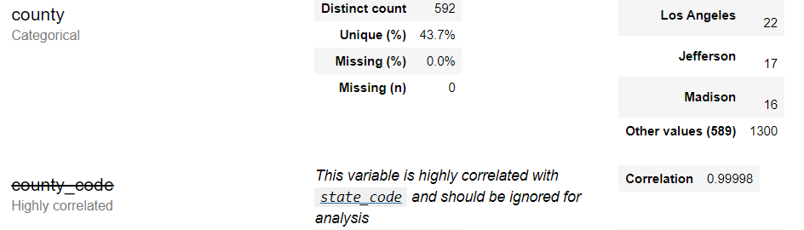
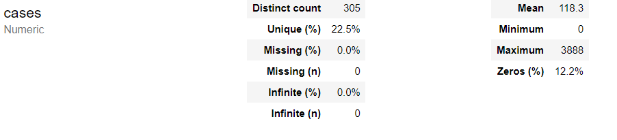
Data Profiling
Statistics of each column used in the project

Slide 7
Data Visualization using Python
Visualizations overview
Utilized multiple csv files to create visualizations
Created visualizations with help of bar graphs, time series analysis and scatter plots
Dashboards to showcase number of cases daily and monthly
Comparing number of cases according to mask usage to see impact
Showcasing demographic information

Slide 8
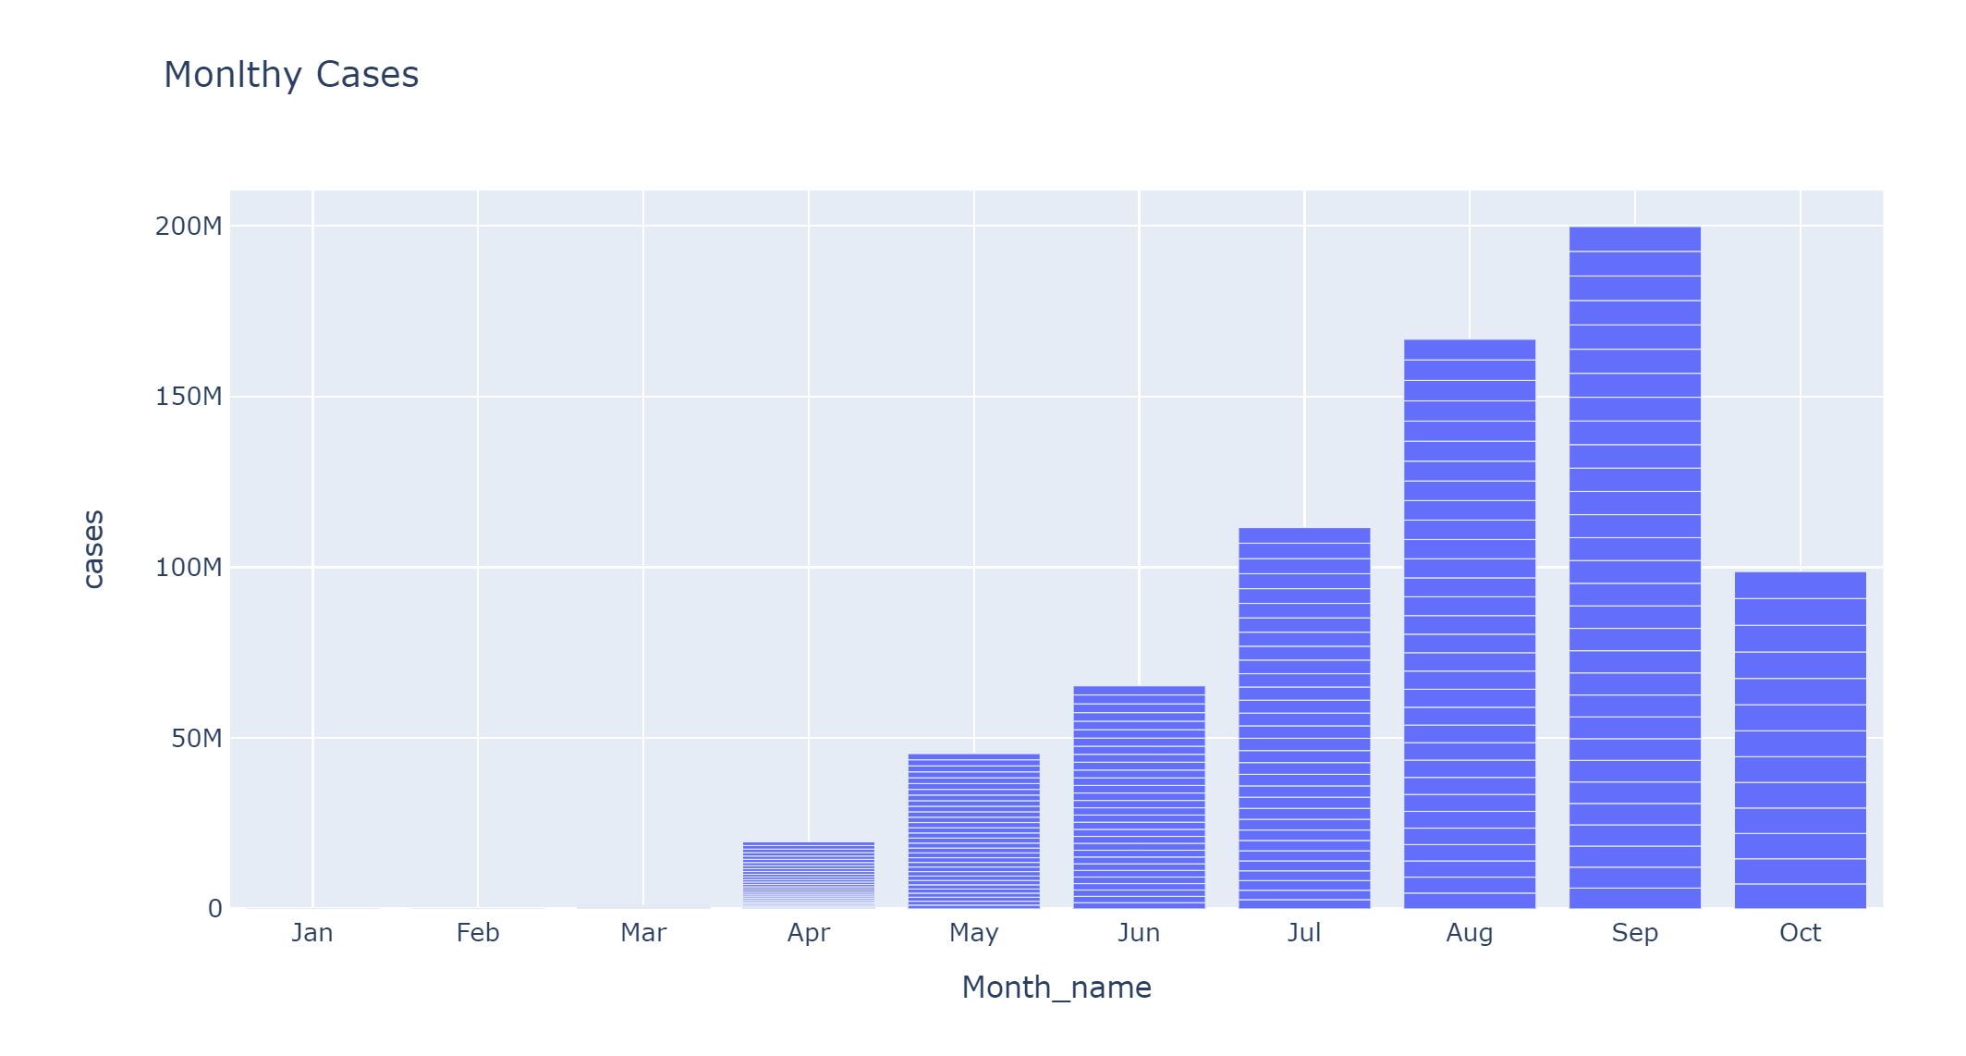
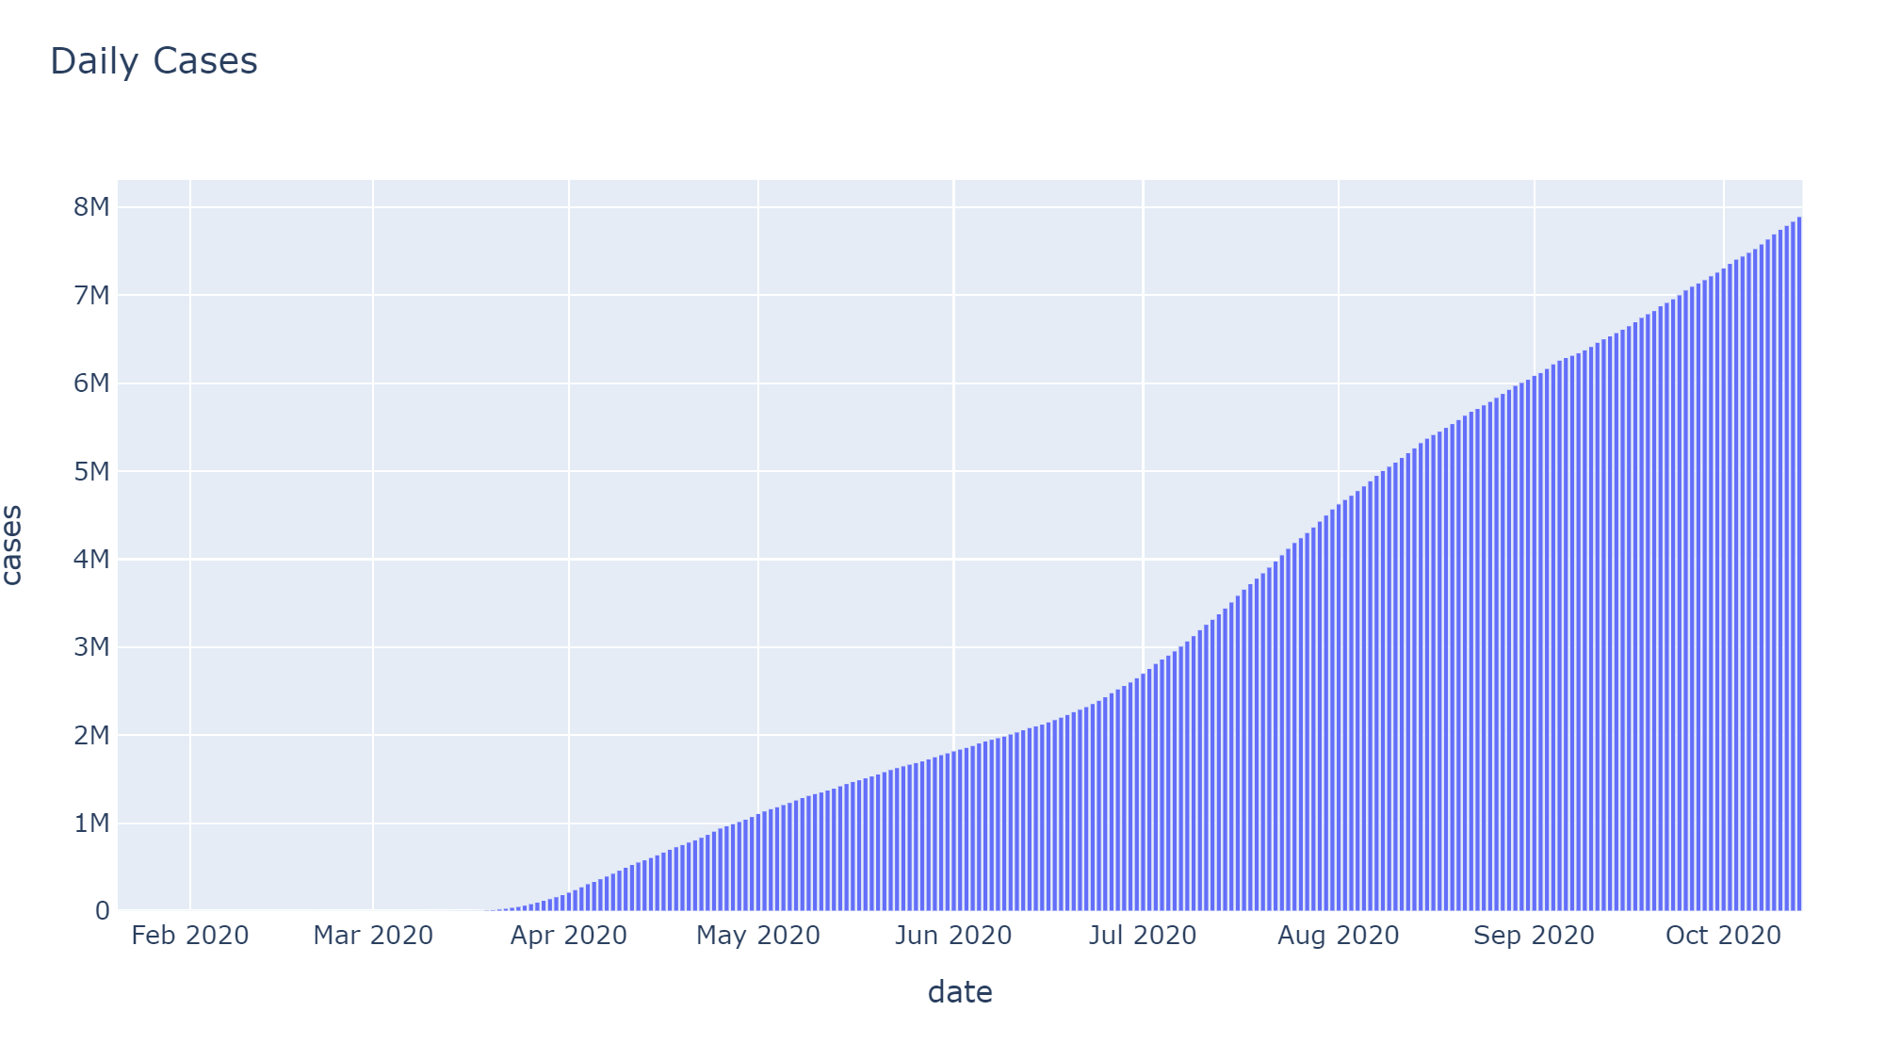
Timeline
Cases in the United States - Monthly and Daily count
Displaying growing no of cases according to Months(fig1) and Dates(fig 2)
Months and Daily: July(90%) records highest growth followed by Aug(41.6%)
Covid-19 cases are increasing exponentially and there is no sign of significant decrease in the number of cases
The data is only available till Oct 13, 2020

Slide 9
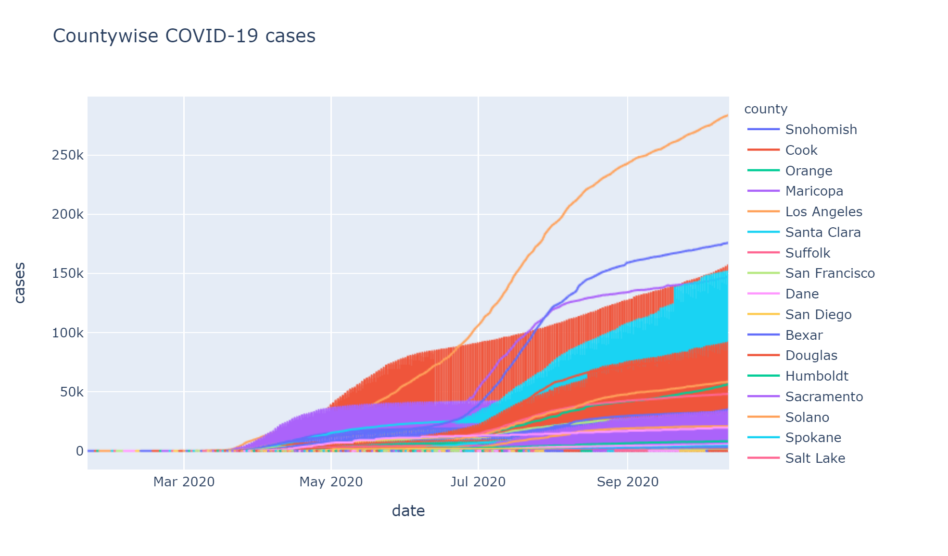
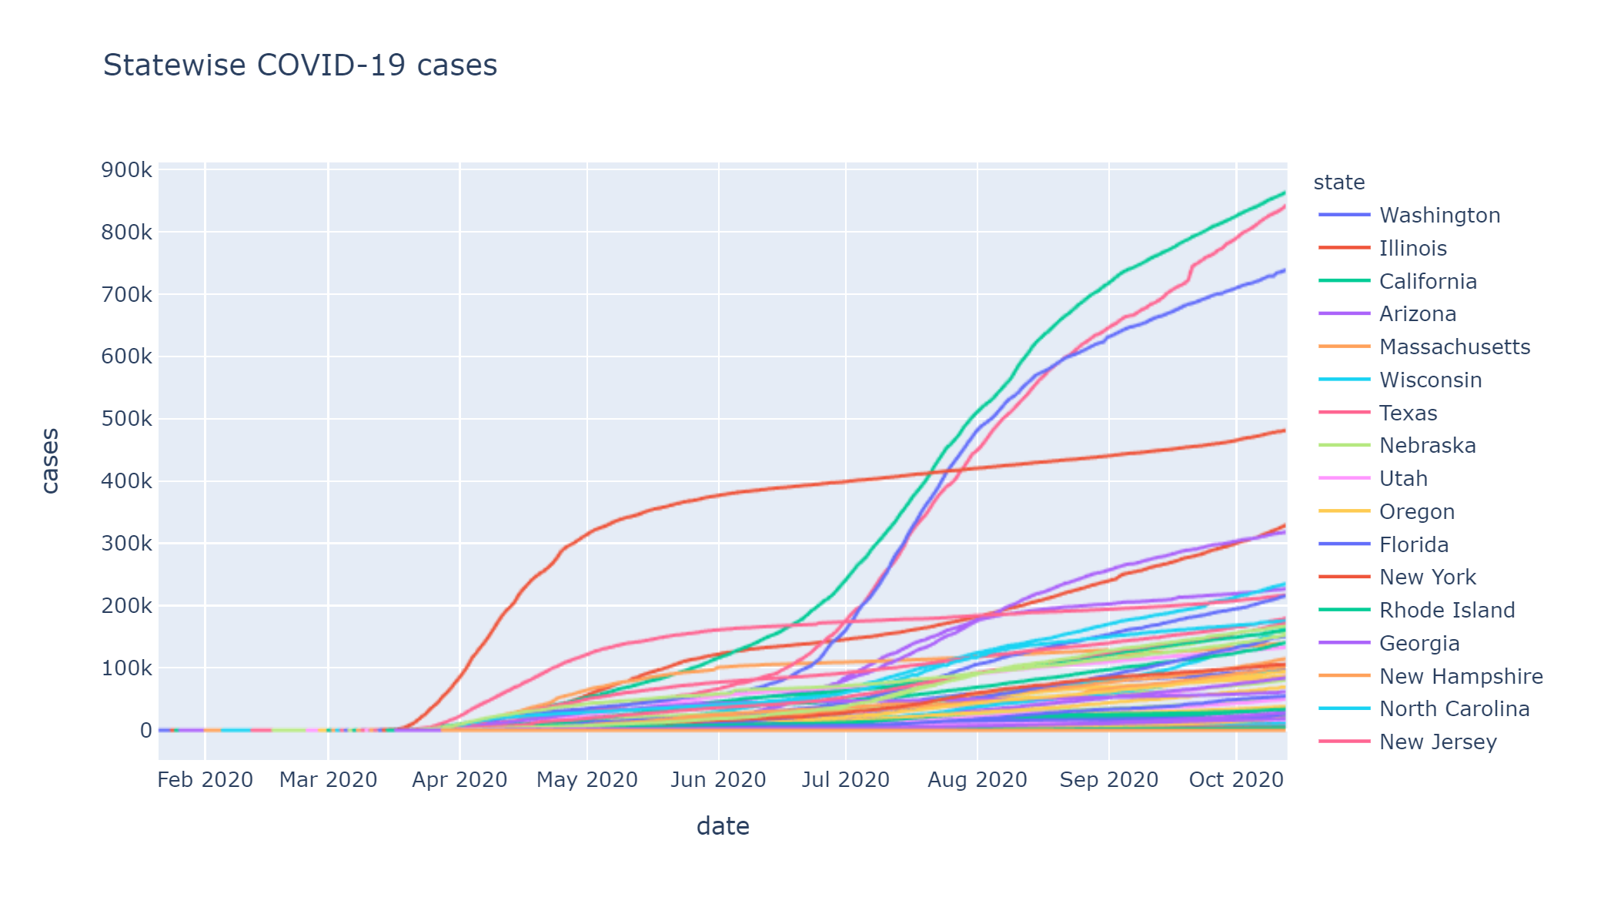
Demographic Information
Time Series Analysis
Displaying growing no of cases according to county(fig1) and state(fig 2)
County: LA records highest no of cases(282.98k) while King is lowest (1)
State: California has highest no of cases(863.14k) while Guam is lowest (4235)
Covid-19 starts spreading in mid-March, but it starts growing exponentially in June (Ref fig 1)

Slide 10
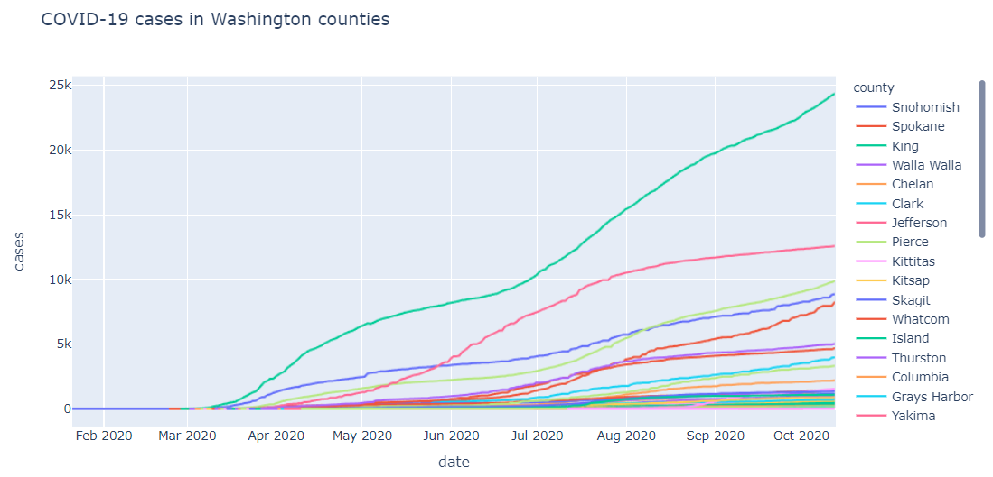
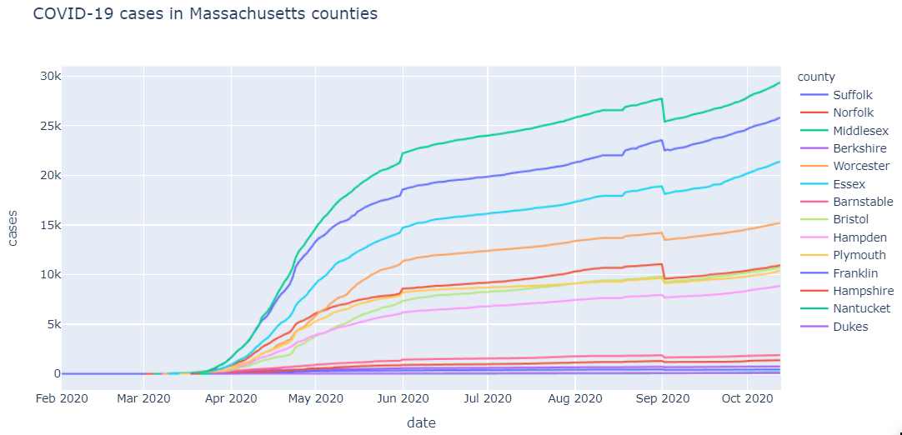
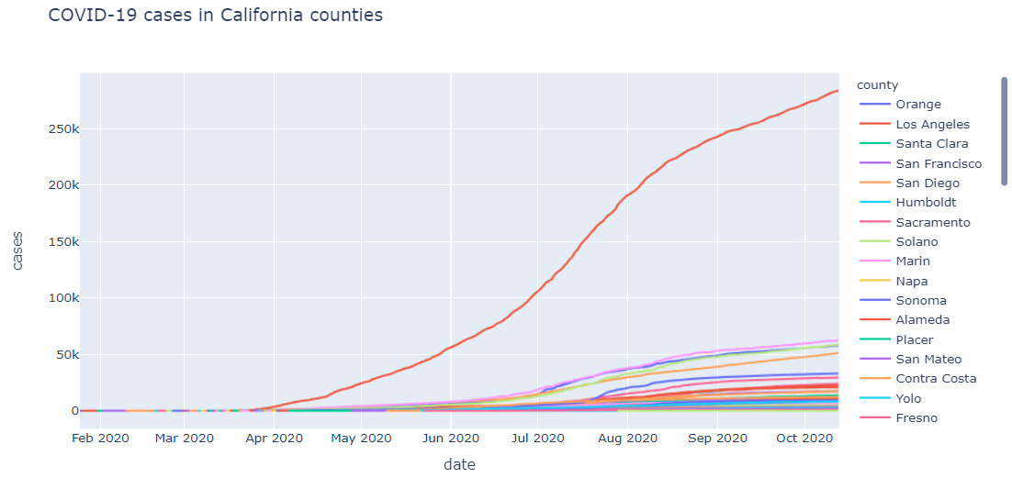
County wise cases – a closer look

Slide 11
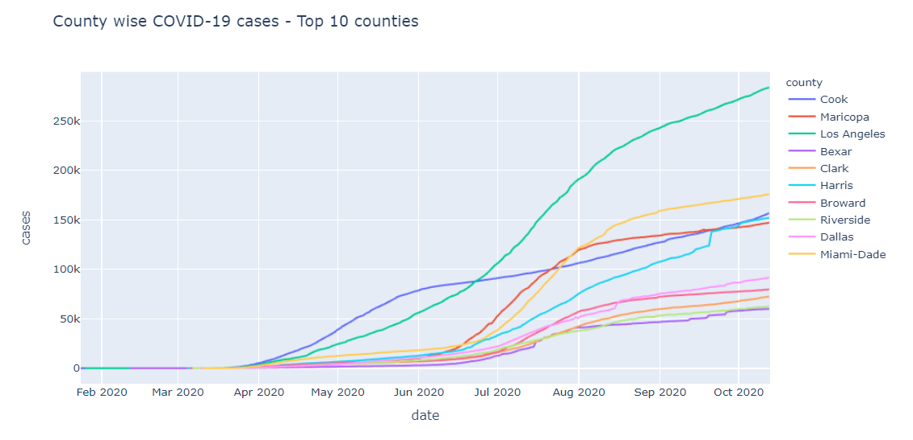
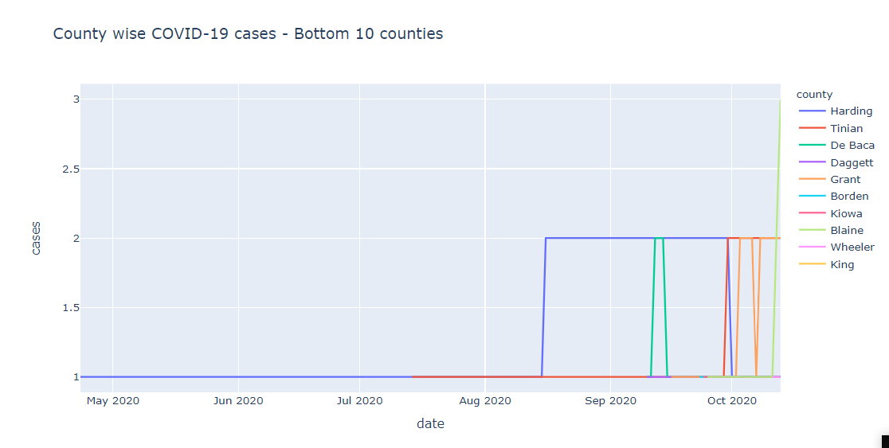
County wise cases
Top 10 and Bottom 10 Counties
Plot shows case progression in counties that recorded the highest number of cases in a day(Fig 1) and the lowest number of cases in a day(Fig 2)
Los Angeles county in California recorded highest number of cases in a day and Daggett in Utah recorded lowest number of cases

Slide 12
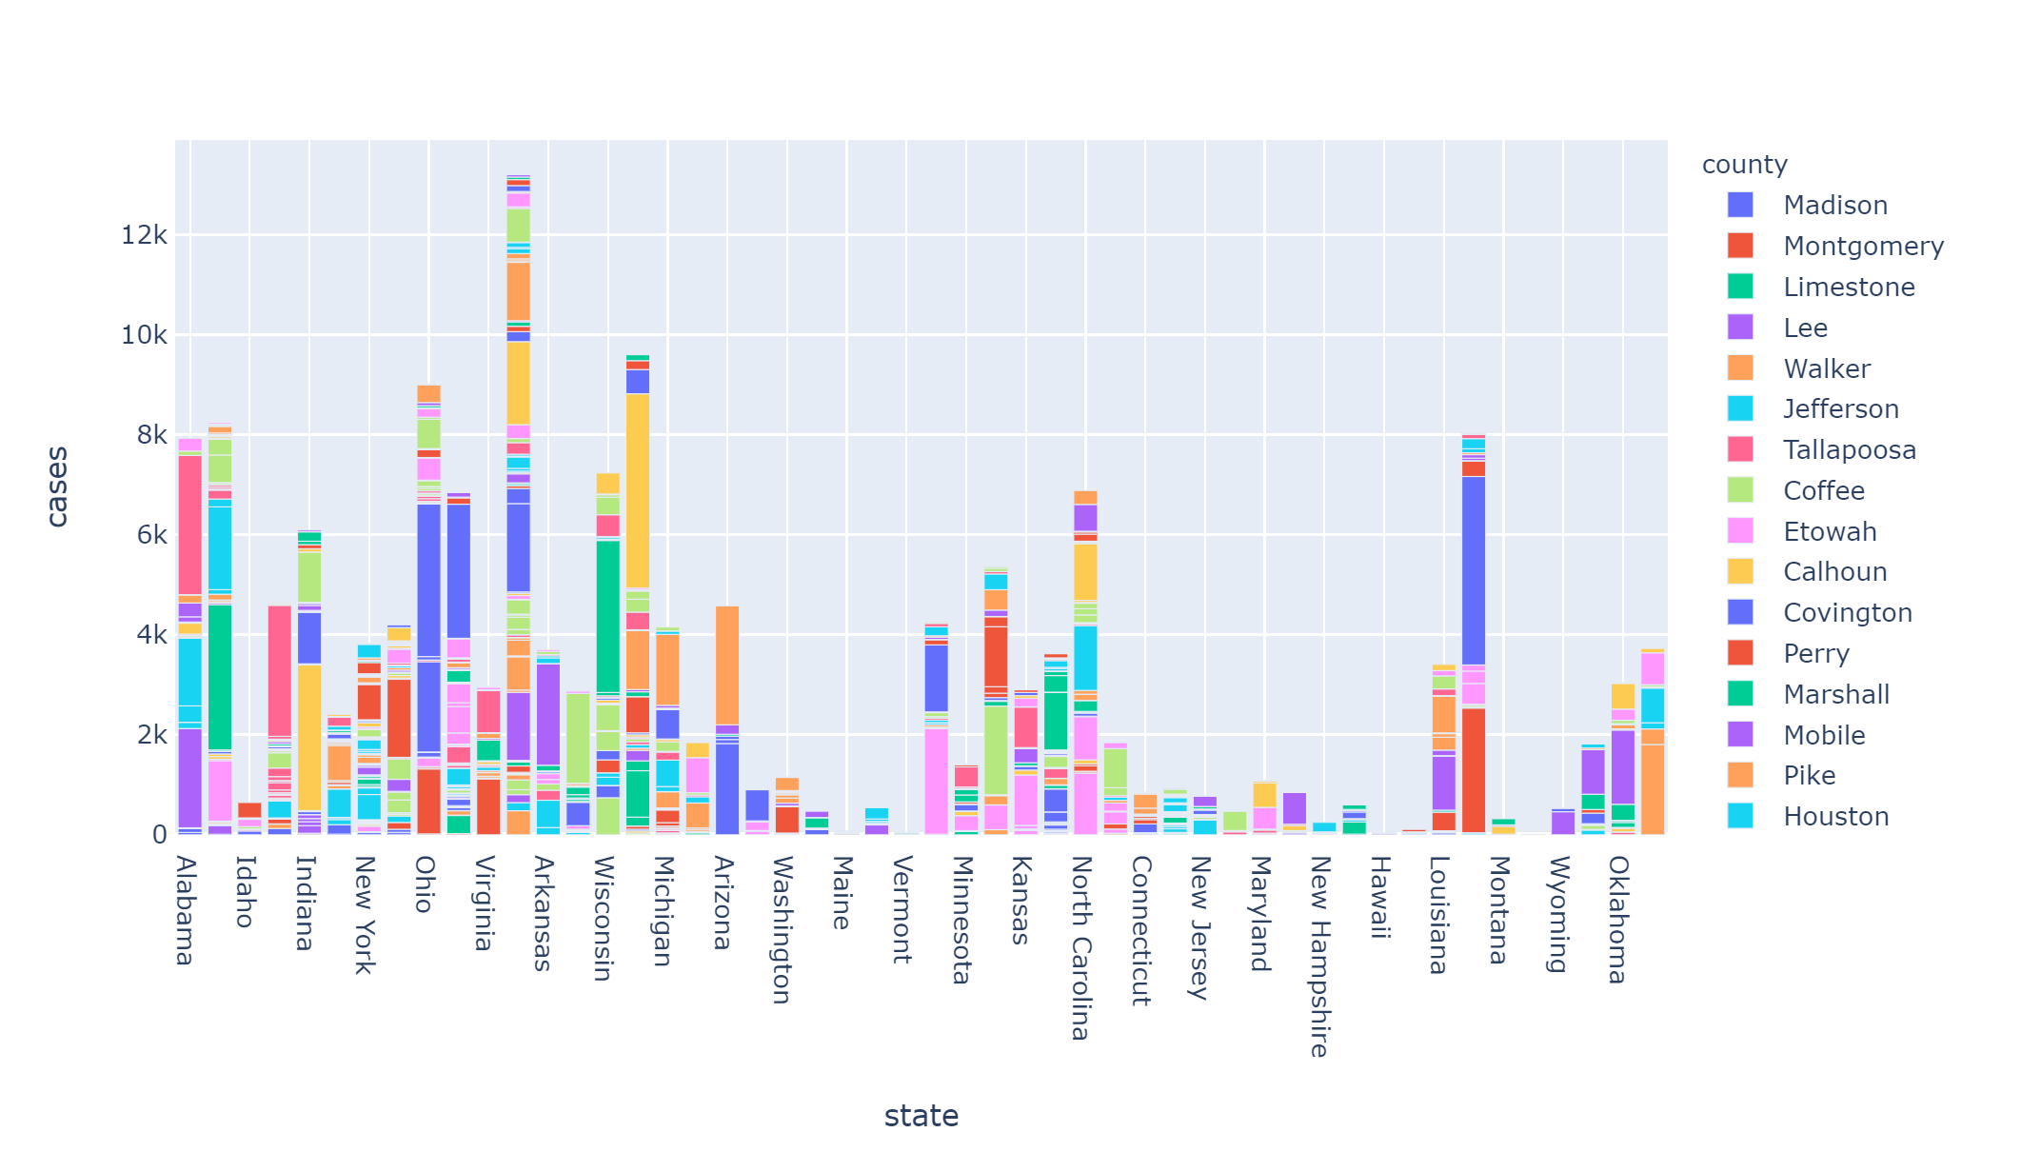
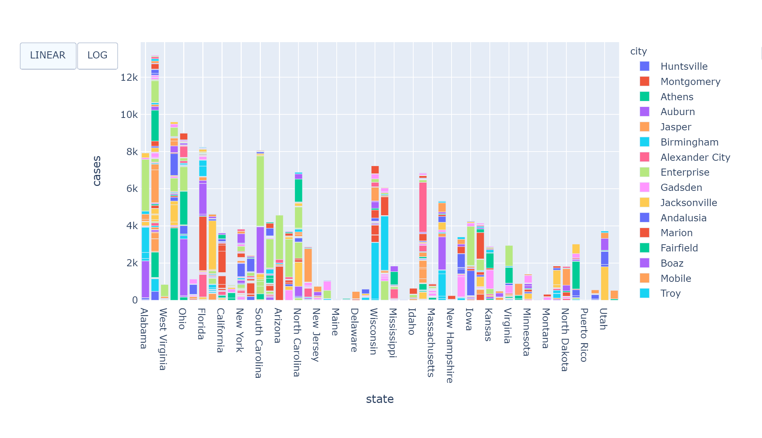
Cases at the university level
State wise, County wise, City wise
Each state has counties assigned to them by different color
According to observations, Texas has highest number of case while lowest in Hawaii
This data contains record of total 50 states and 1927 counties

Slide 13
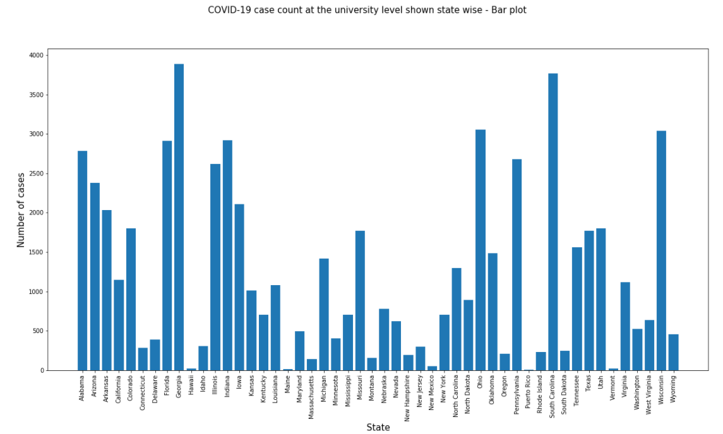
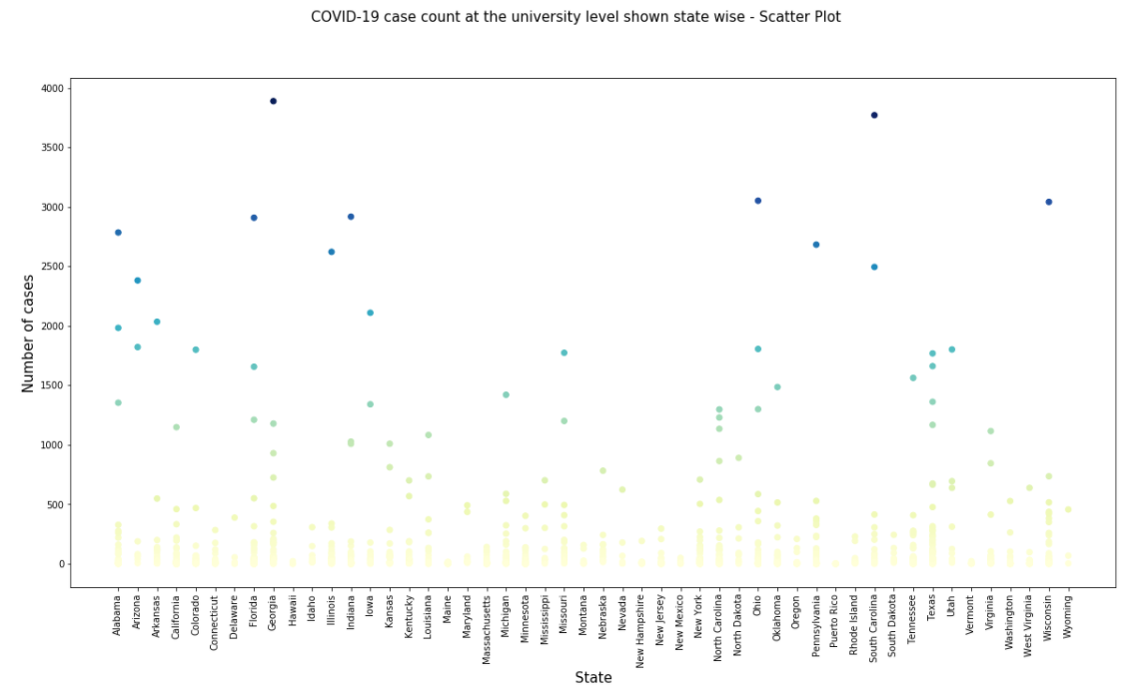
Cases at the university level
State wise
Bar plot and Scatter plot with heat map of cases at the university level shown state wise
States like Georgia and South Carolina have darkest shades and states with lower number of cases have lighter shades

Slide 14
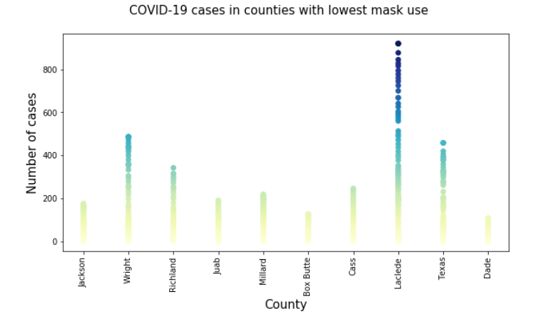
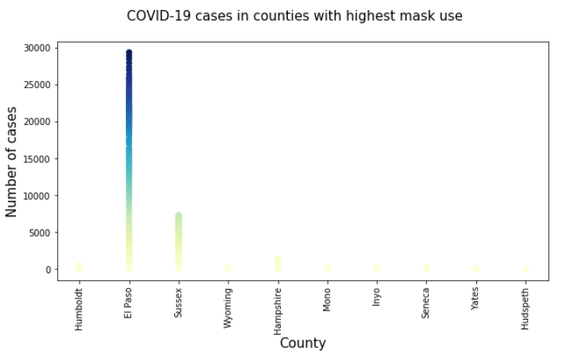
Relationship between mask use and cases- county level
Plot shows counties with lowest mask use(left) and those with most mask use(right) on the x-axis. Number of cases in each has been plotted.
From the graphs, we see that the density of cases is more in the left fig than in the right fig indicating that lower the mask use, more the cases and vice versa

Slide 15
Who would use this dashboard?
Public Health officials
Medical practitioners
General public
Students
Researchers
Fellow Data Visualizers

Slide 16
Neo4j

Slide 17
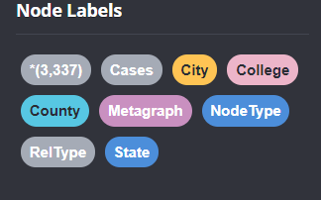
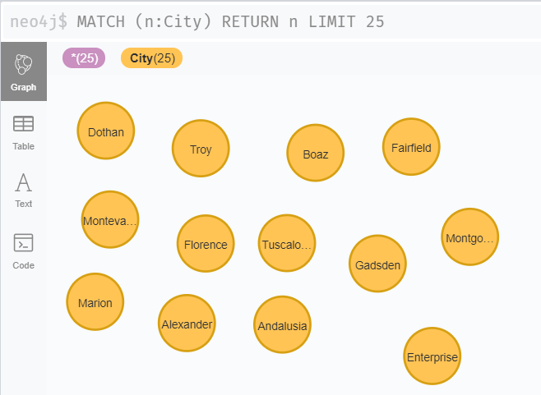
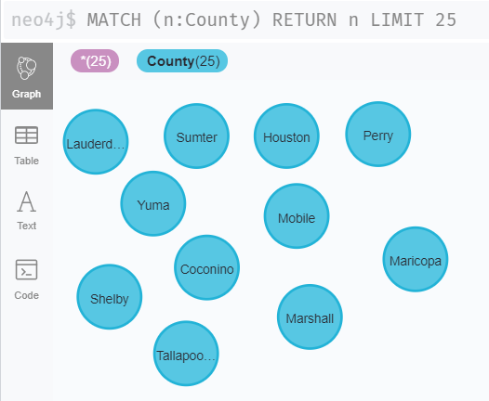
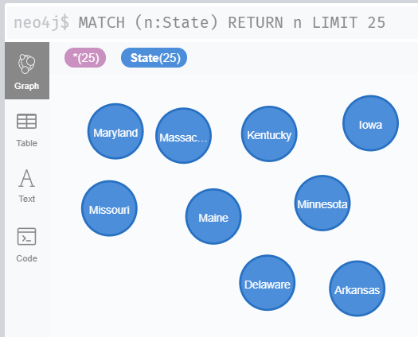
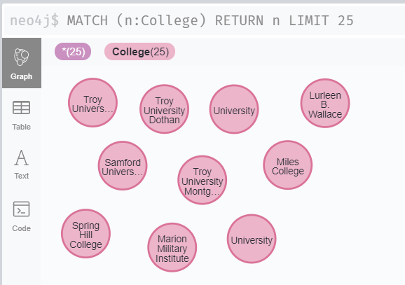
Data Mapping and Integration
Created below nodes in Neo4j and stored different properties in each node
College
City
County
State
Cases

Slide 18
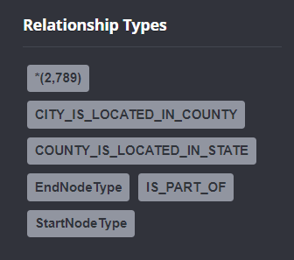
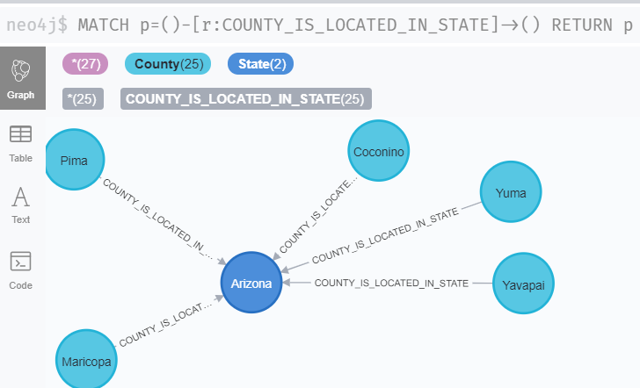
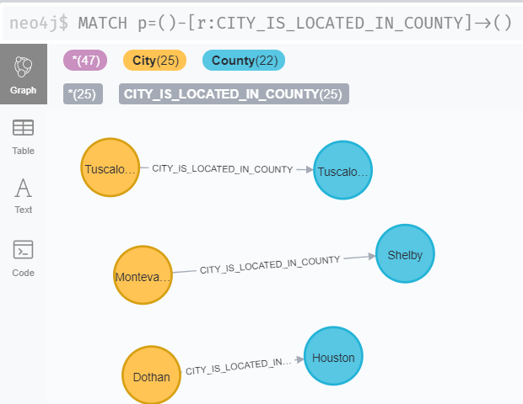
Data Mapping and Integration
Created Relationships in Neo4j to show the mapping between the various nodes and how they are connected

Slide 19
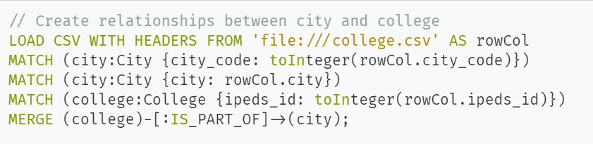
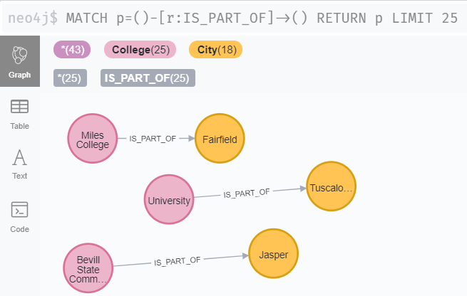
Data Mapping and Integration

Slide 20
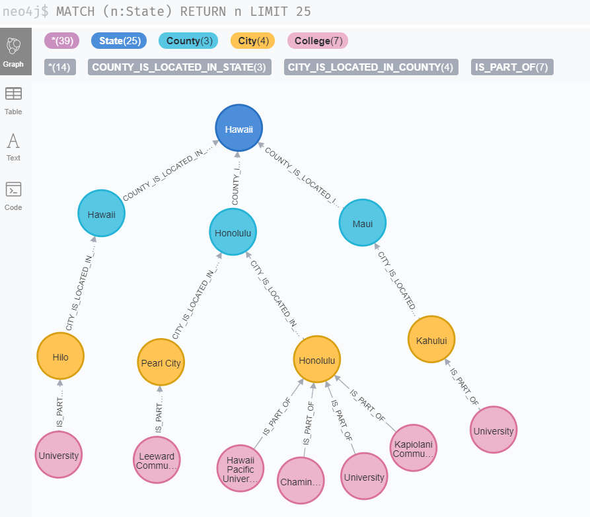
Nodes and Relationship mapping

Slide 21
Risks, Issues and Challenges
 | Description
Challenge | Understanding Neo4j
Challenge | Designing Neo4j database
Challenge | Modifying dataset so as to make it usable for Neo4j database which meant creating and replicating multiple columns in the dataset CVSs
Issue | The script to extract technical metadata from Neo4j wouldn't run. Solution was to disable offline mode and to install a plugin 'APOC'.
Issue | Neo4j threw Memory Heap Error while loading dataset. Issue was that the dataset was too big for Neo4j to handle. Solution was to use a command to load the file periodically.
Issue | In the dataset, multiple cities had the same city code which resulted in numerous duplicates in our Neo4j database. Solution was to combine city code with state code and county code to create a unique identifier for cities.

Slide 22
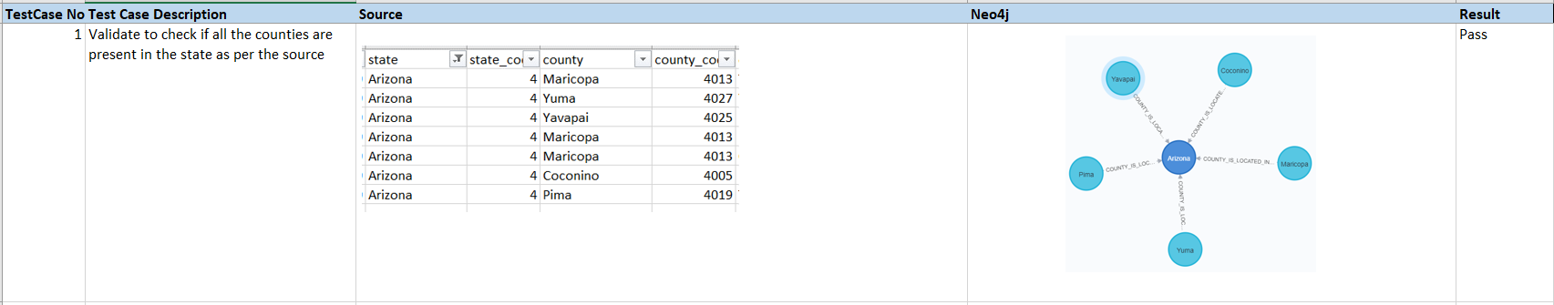
System Integration and User Acceptance
Validated if the nodes created matches with the dataset
Validated the hierarchy of the nodes and relationship in Neo4j and the dataset
Implemented below testcases
Validate to check if all the counties are present in the state as per the source
Validate to check if all the cities are present in the county
Validate to check if all the Colleges are present in the city
Validate to check if the correct number of cases are displayed for each College
To validate the hierarchy and relationship of all the nodes

Slide 23
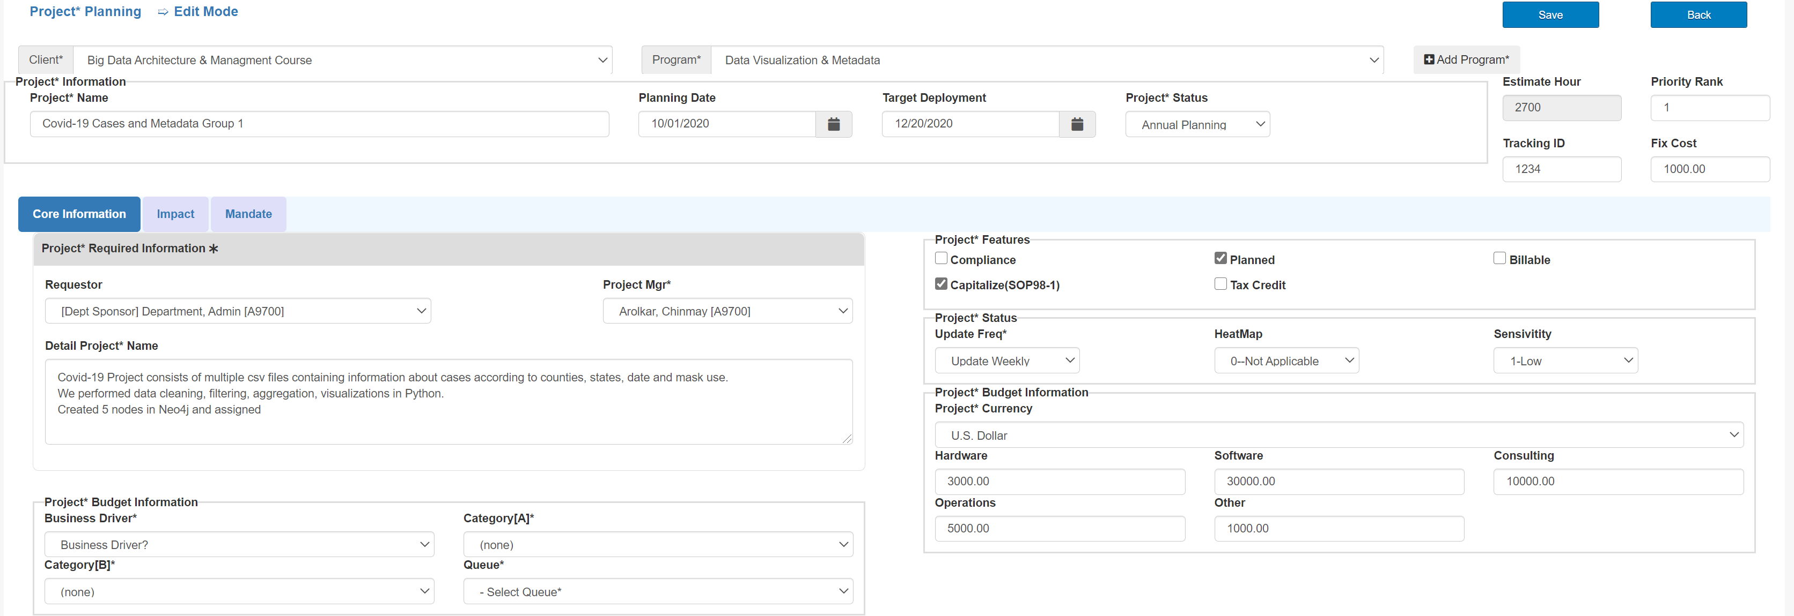
Valero
Long Form: The Core information about the project.

Slide 24
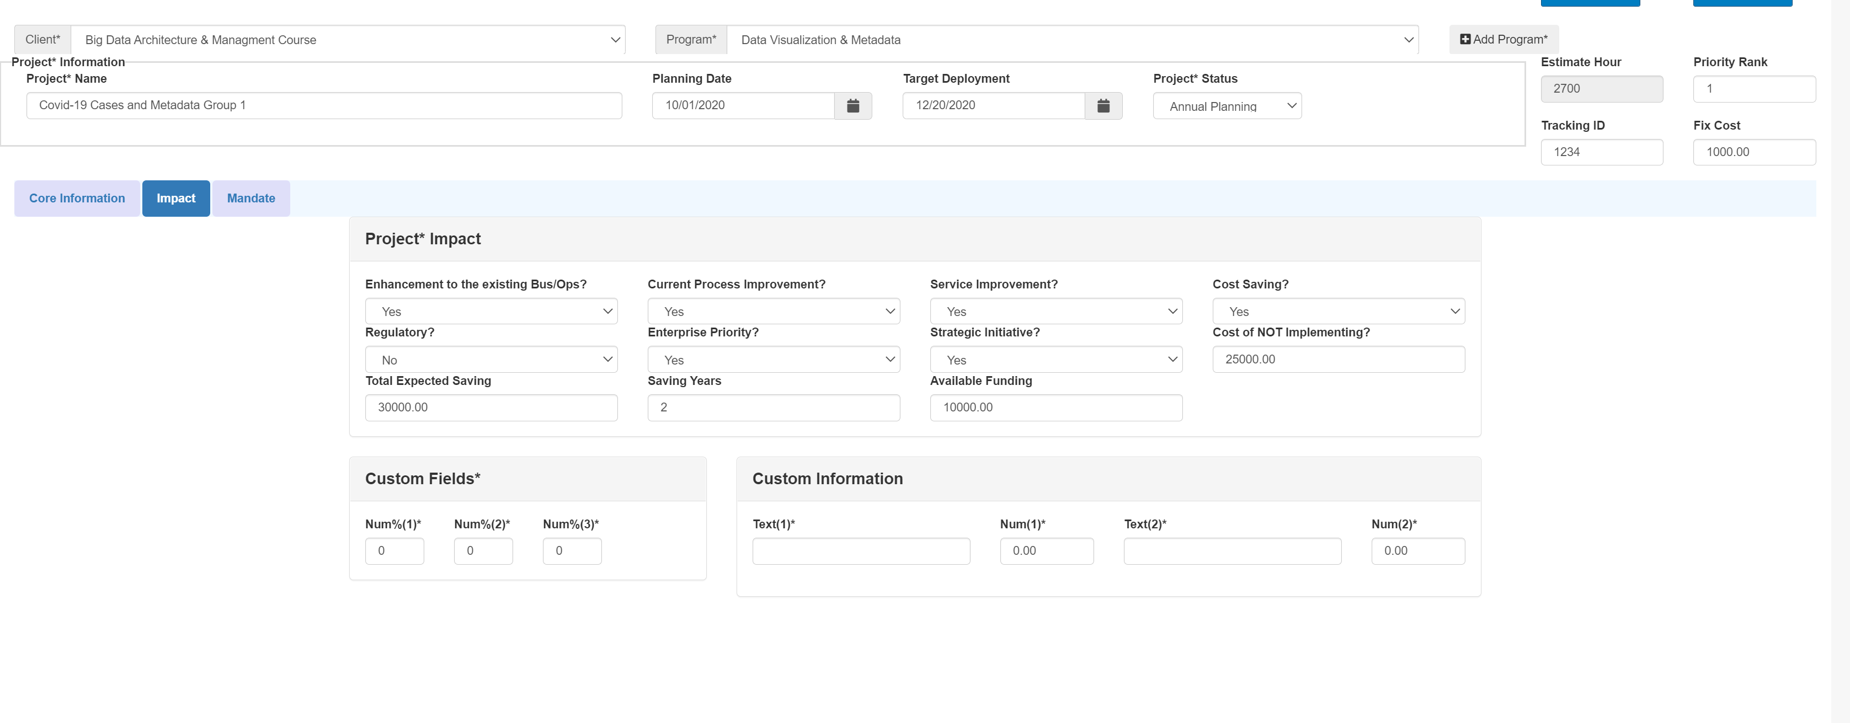
Valero
Long Form: Additional information in impact tab

Slide 25
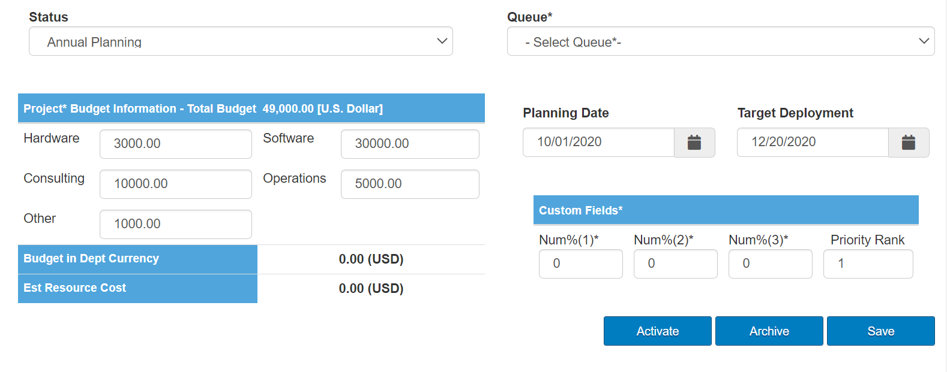
Valero
Short Form: Information about budget

Slide 26
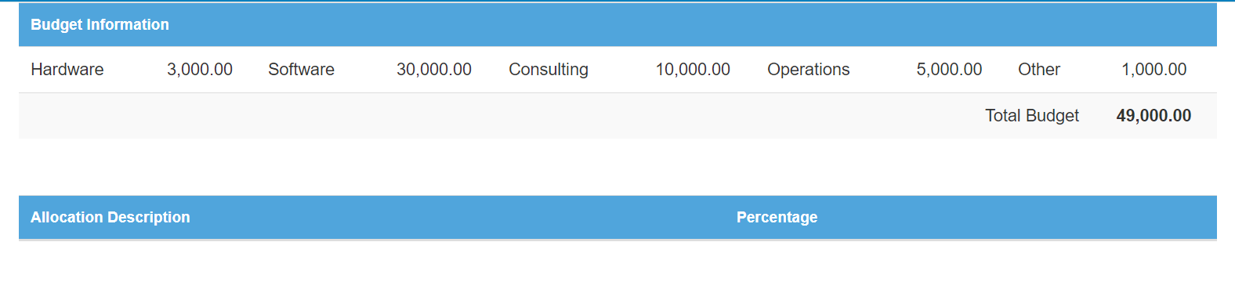
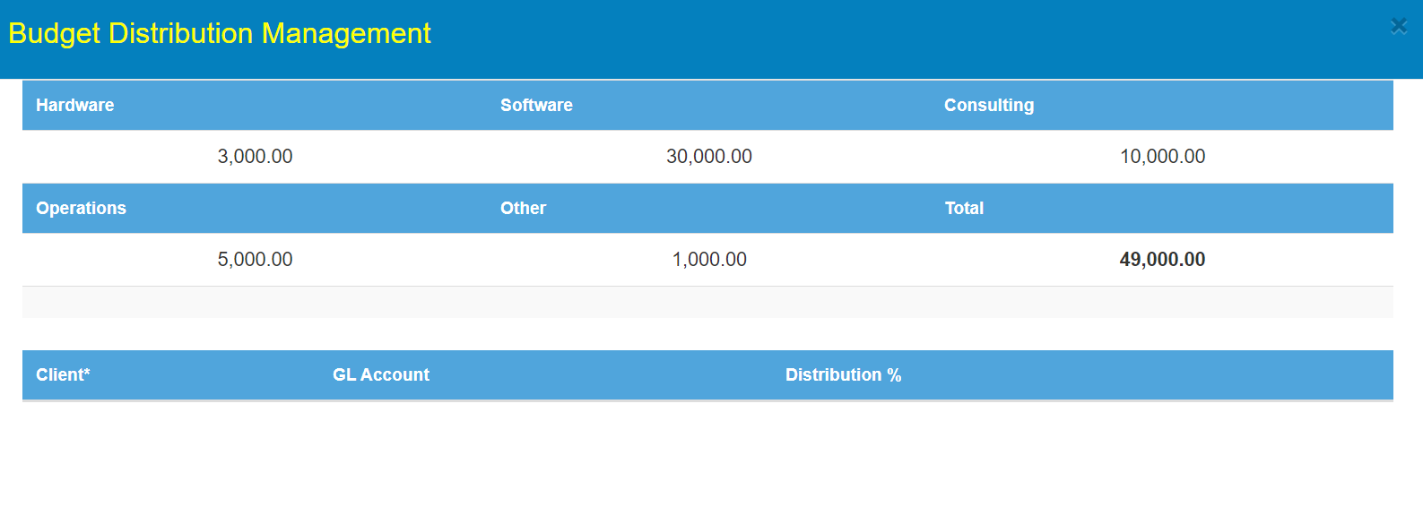
Valero
Budget Information: Information related to budget distribution

Slide 27
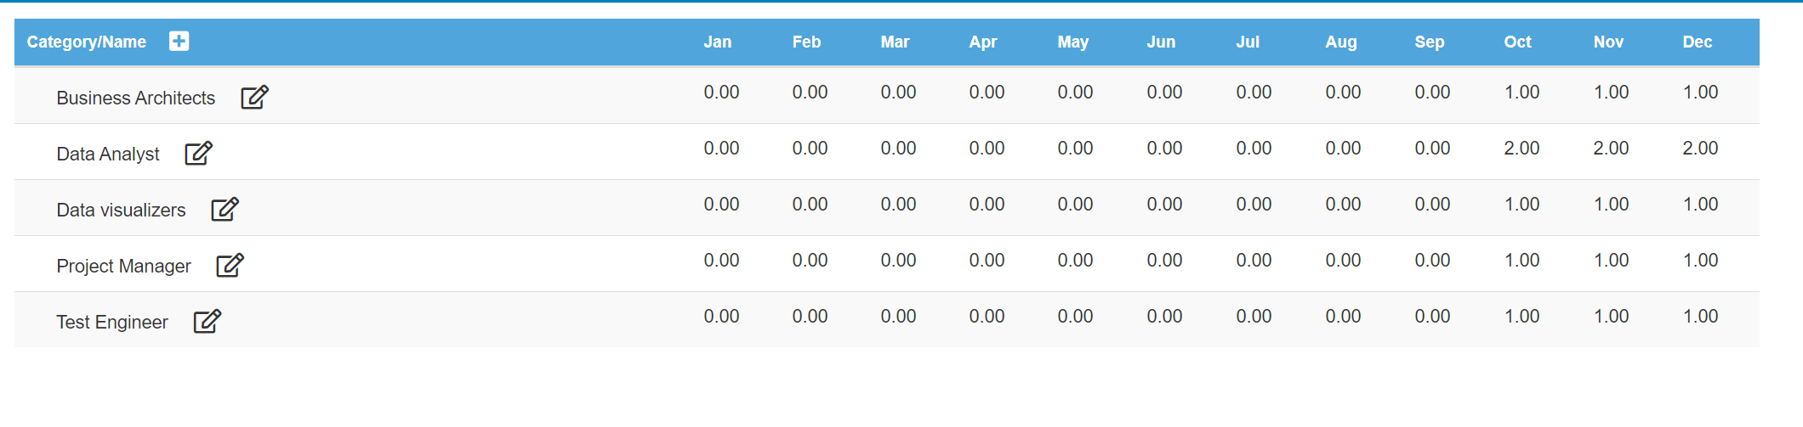
Valero
Resource Planning: Group allocation required to complete this project

Slide 28
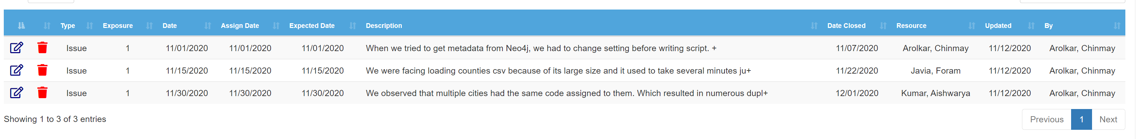
Valero
Risk and Issues:

Slide 29
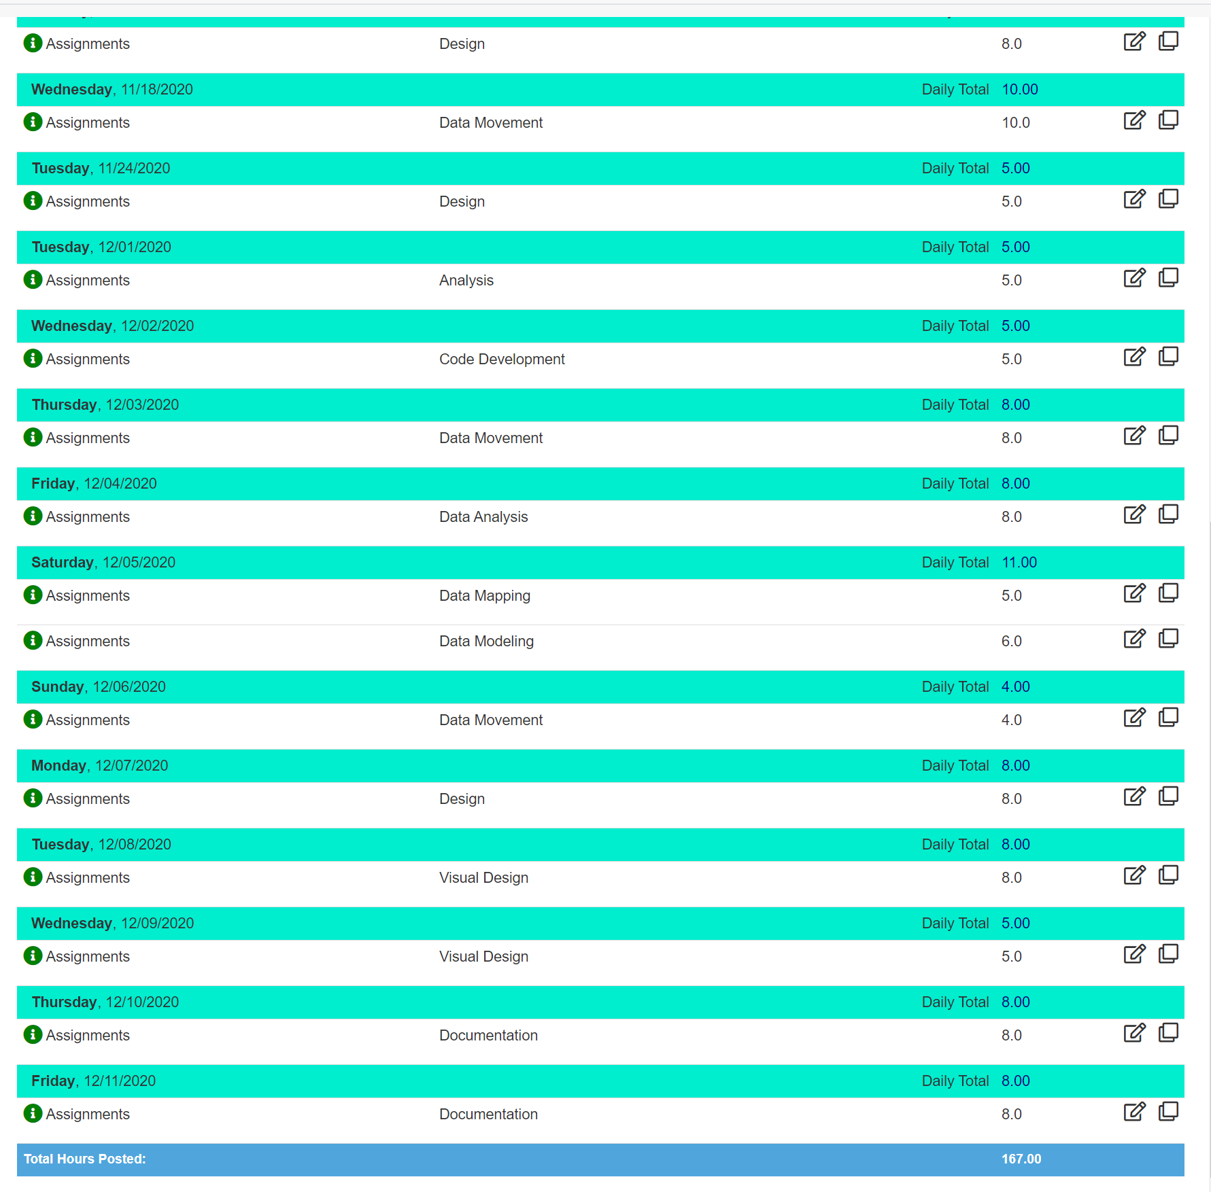
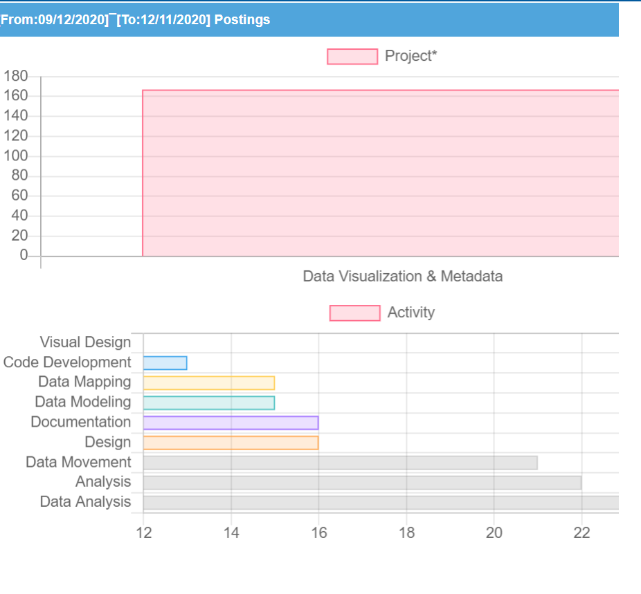
Valero
Timesheet: Contains detailed information about total no of hours required throughout the project

Slide 30
Thank you

